Slide 3
Reward consumers
Badges (really cool ones)
Pedometer
Special quests: sightseeing , offbrand pokemon go ( stars?)
World leader board ( just position no names) ( just names???)

Slide 4
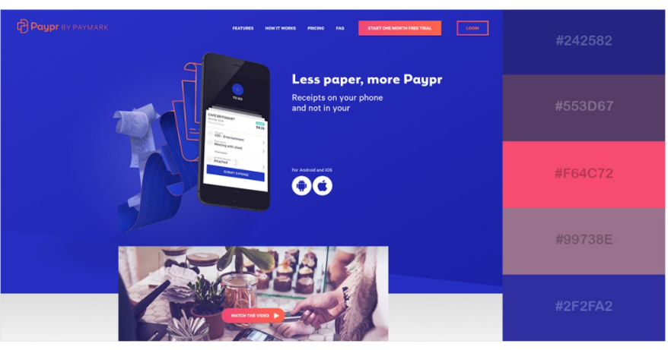
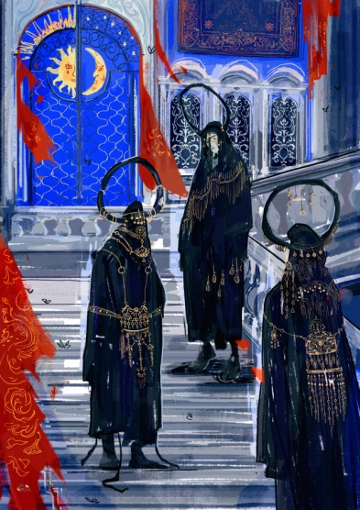
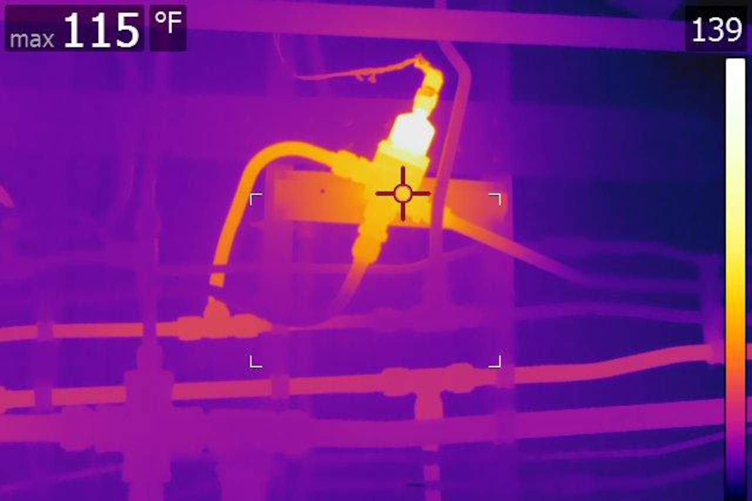

Slide 5
